Slide 1
SSW-810: Software Engineering Tools and Techniques
Python Fundamentals
Prof. Jim Rowland
Software Engineering
School of Systems and Enterprises

Slide 2
Acknowledgements
This lecture includes material from
“How to Think Like a Computer Scientist: Learning with Python 3 (RLE)”, Peter Wentworth, Jeffrey Elkner, Allen B. Downey, and Chris Meyers,
http://openbookproject.net/thinkcs/python/english3e/
And
“Introducing Python”, Bill Lubanovic, ISBN-13: 978-1449359362
http://proquest.safaribooksonline.com/book/programming/python/9781449361167

Slide 3

Today’s topics
Programming languages
Python
Python primitives
Variables
Statements
Expressions
Operators/Operands
Functions
Spyder: Integrated Development Environment

Slide 4
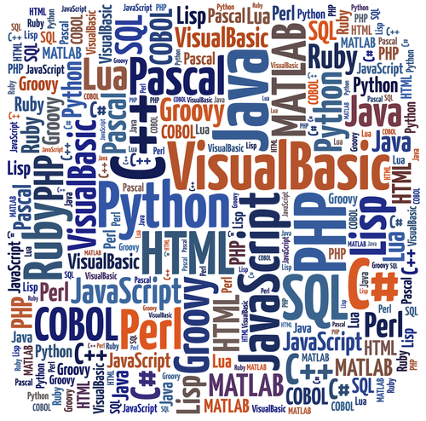
Programming languages
Many choices:
Procedural
Object Oriented
Functional
Many others…

Slide 5

Python
“Python is now the Most Popular Introductory Teaching Language at Top U.S. Universities”¹ – CACM
Widely used in academia and industry
“Batteries included” - 87K+ packages:
Machine Learning, Data Science, database management, Scientific computing, visualization, …
Open source
Extensive user community, documentation, applications
¹http://cacm.acm.org/blogs/blog-cacm/176450-python-is-now-the-most-popular-introductory-teaching-language-at-top-us-universities/fulltext

Slide 6
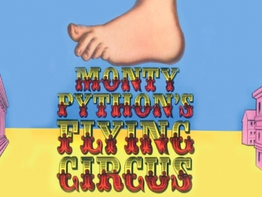
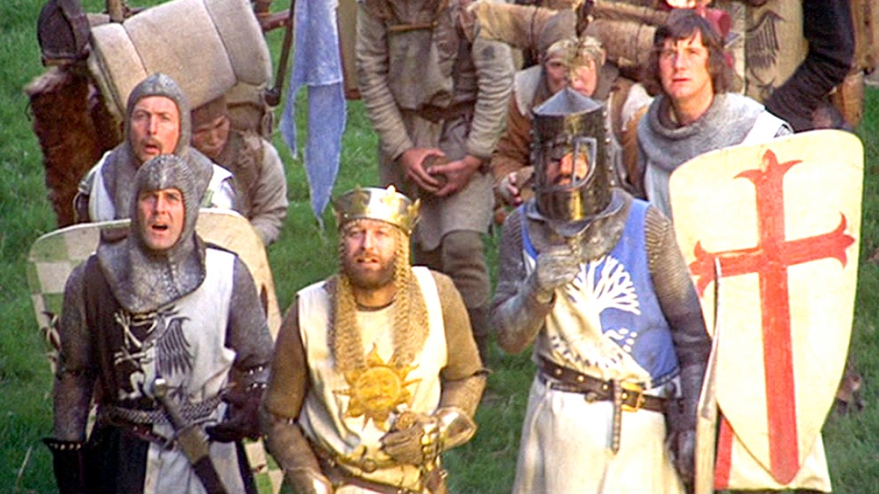
Why the name Python?
Python’s creator, and Benevolent Dictator For Life, Guido van Rossum, was a big Monty Python Fan
Source: https://docs.python.org/3/faq/general.html

Slide 7
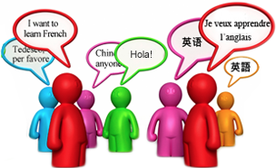
Spoken language features
Languages have syntax, structure, and rules
Words
“hello”, “world”, …
Grammars
<sentence> := <NounPhrase> <VerbPhrase> <NounPhrase>
Valid sentence
I’m excited to learn programming with Python.
Invalid sentence
excited Python. to with I’m programming learn

Slide 8
Language features
We learn new vocabulary and rules to speak new languages
Learning a programming language is like learning a new language, but easier!

Slide 9
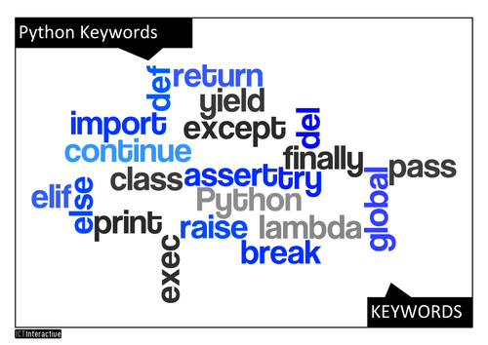
Speaking Python
Python has a relatively small set of words and syntax

Slide 10
Talking to Python
Courier Font signals Python code
Say hello!
>>> print('Hello world!')
Hello world!
>>>
Python is an interpreted language
Commands are parsed and executed interactively
No need to compile
If you’re unsure of what Python would do, try it!!!
Designing Python experiments is a critical skill
You type the stuff in blue
Black text is output from Python

Slide 11
What else can we do with Python?
Python Prompt
Value of 3
>>> 3
3
>>> 3 + 4
7
>>> 3 == 4
False
>>> (3 + 5) <= 8
True
>>>
Boolean Comparison

Slide 12
Ooops! No problem!
$ >>> foo
Traceback (most recent call last):
File "<stdin>", line 1, in <module>
NameError: name 'foo' is not defined
>>> print('Hello world!’)
Hello world!
>>>
Python doesn’t know about foo
No problem! Keep going…

Slide 13
Store Python programs in a file
Experimenting interactively is great for exploration!
Write Python code in a file to save it and run the file
$ cat program00.py
print('This Python program is in a file')
print(2 + 2)
$ python program00.py
This Python program is in a file
4

Slide 14
Common programming tasks
Input/Output
Read from user or files
Write to user or files
Calculations
Conditional execution
If something is True Then do X, Otherwise do Y
Repetition
For each integer from 1 to 100 perform some calculation
For each word in a paragraph, identify the distinct words

Slide 15
Booleans: another Python type
Numbers & Strings are types
42, 3.14157, ‘Hello world’, “Hello back”
Booleans
True, False
Expressions may evaluate to a boolean
>>> 3 <= 4
True
>>> 'Hello' == 'Hello'
True
>>> 3 > 4
False

Slide 16
Variables
Think back to high school algebra
a² + b² = c²
Python uses a variable to reference a value

Slide 17
Variables
Python uses a variable to reference a value
Assign a value to a variable with =
>>> message = 'Hello world’
>>> n = 42
>>> pi = 3.14157
>>> message
'Hello world’
>>> n
42
>>> pi
3.14157

Slide 18
The value of a variable may change
>>> n = 42
>>> n
42
>>> n = 197 # assign a new value to n
>>> n
197
>>> n = 2 + 3
>>> n
5
>>> n = n + n
>>> n
10

Slide 19
Naming variables
Variable names can have arbitrary length
Variable names can include:
Letters [A-Z][a-z]
Underscores ‘_’
Numerals (except the first character)
Examples
My_favorite_variable_name
Question42
mixUpperAndLowerCaseCharactersAndDigits56
Variable names may NOT begin with a digit

Slide 20
Variable names are case sensitive
>>> n = 3
>>> N = 4
>>> n
3
>>> N
4
Everything in Python is case sensitive!

Slide 21
Python keywords (reserved words)
Python reserves some words that can’t be used as names
and | as | assert | break | class
continue | def | del | elif | else
except | exec | finally | for | from
global | if | import | in | is
lamba | nonlocal | not | or | pass
raise | return | try | while | with
yield | True | False | None

Slide 22
Python keywords
Python keywords can’t be used as variable names >>> and = 3
File "<stdin>", line 1
and = 3
^
SyntaxError: invalid syntax

Slide 23
Choose meaningful variable names
Programs live a long time (10+ years)
Choose meaningful variable names
Help you to remember
Help others who read your program
Single character variable names are usually a bad idea
c = 42 # I wonder what ‘c’ is???
cnt = 42 # counting something

Slide 24
Python statements
Statements allow us to tell Python what we want to do
Examples of statements
cnt = 42 # assignment statement
while
if
for
The Python interpreter evaluates statements
Statements don’t produce results

Slide 25
Python expressions
Expressions are combinations of values, variables, and function calls
>>> cnt = 42
>>> cnt
42
>>> len("Hello world")
11
>>> 3 * 4 + 5
17
This is an statement so no output
Evaluate the expression cnt
Call a function

Slide 26
Operators and operands
Operators are special reserved tokens that instruct Python to perform operations on operands
+, -, *, / Addition, subtraction, multiplication, division
//, ** Integer division, exponentiation
% modulus (remainder)
Operands are the values used by operators
3 + 5
(hours * 60) + minutes
‘Hello ‘ + ‘world’
Variables are operands
String concatenation

Slide 27
Order of operations
What is the value of 3 + 4 * 5 - 6?
((3 + 4) * 5) - 6 # Left to right?
(3 + 4) * (5 - 6)) # addition takes precedence?
3 + (4 * 5) - 6 # multiplication takes precedence?
Try it!
>>> 3 + 4 * 5 – 6
17
Why?
Multiplication/division takes precedence over addition/subtraction

Slide 28
PEMDAS: Order of operations
P – Parentheses
E – Exponentiation
MD – Multiplication/Division
AS – Addition/Subtraction
Left to right
Examples
2 / 2 – 3 + 4 == ((2/2) – 3) + 4 == 2
2 ** 1 + 4 == (2¹) + 4 == 6

Slide 29

Order of operations
Always use parentheses to avoid confusion
We want our code to be easy to read and understand
Reading code is hard: don’t make it harder
Be explicit!

Slide 30
Python functions
Functions are operands that can be used in expressions and statements
Functions are just like mathematical functions
Call a function with 0 or more arguments
>>> len("Hello world")
11
>>> int(3.999999)
3
>>> int('3')
3
>>> type(int('3'))
<class 'int'>
Truncate, not round
Convert string ‘3’ to an integer

Slide 31
Getting input from the user
Python provides a function to get input from a user
>>> response = input('Please enter a number: ')
Please enter a number: 42
>>> response
'42’
>>> response + 1
Traceback (most recent call last): File "<stdin>", line 1, in <module>TypeError: Can't convert 'int' object to str implicitly
>>> int(response)+ 1
43
>>> float(response)+ 1
43.0
Input returns a string
Cast strings to integers or floats to do math

Slide 32
Printing output to the user
Python’s print function writes output to the user
>>> print(‘Hello world!’)
Hello world!
>>> name = ‘Jim’
>>> number = 42
>>> print(‘My name is‘, name, ‘and my favorite number is‘, number)
My name is Jim and my favorite number is 42
Print accepts any number of arguments of many types

Slide 33
Nesting function calls (Composition)
Area = π r²
response = input("Radius: ")
r = float(response)
area = 3.14159 * (r**2)
print("Area=", area)
Is equivalent to
r = float(input("Radius: "))
print("Area=", 3.14159 * (r**2))
Readability is important: you choose!

Slide 34

Questions?

